Slide 1


Artificial Intelligence as a risk and opportunity for the authenticity of archives
Heider Jeffer
Supervisors Prof. Koraljka Golub (KG), Principal Investigator
Prof. Marcelo Milrad (MM), Co-Investigator
Prof. Saara Talas (ST), Co-Investigator
Prof. Anna Foka (AF), Principal Investigator
Prof. Isto Huvila (IH), Co-Investigator

Slide 2
You can follow this project at GitHub
AT: https://github.com/HeiderJeffer/Ph.D-position-at-Linnaeus-University

Slide 3
Why I Chose this Project?

Slide 4

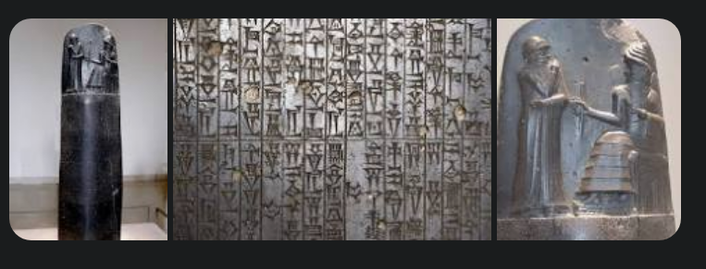
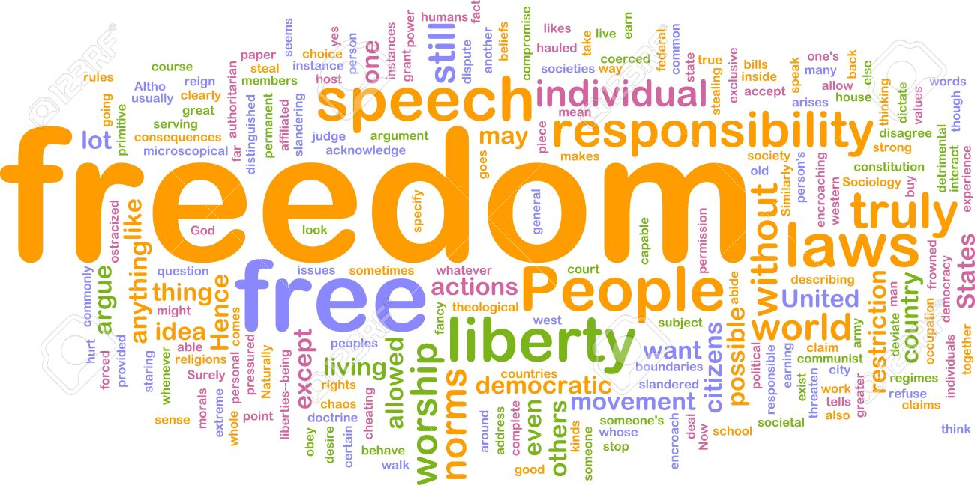
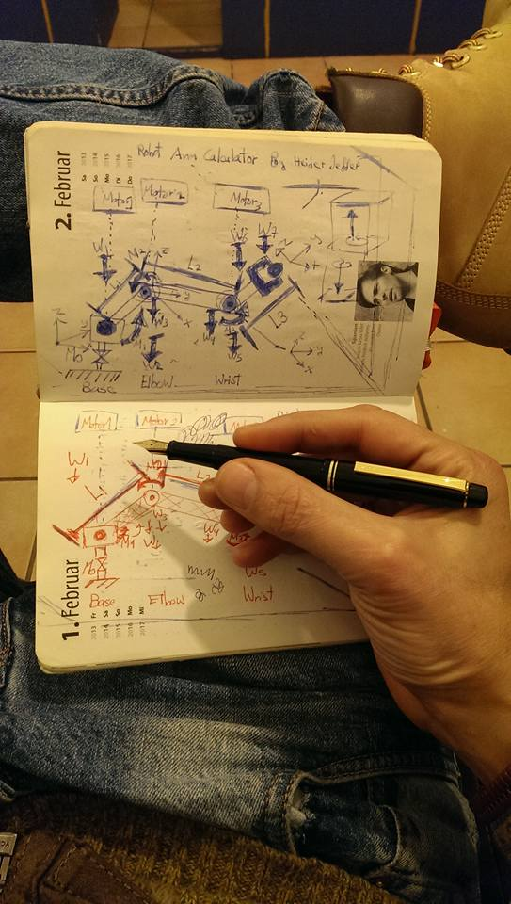
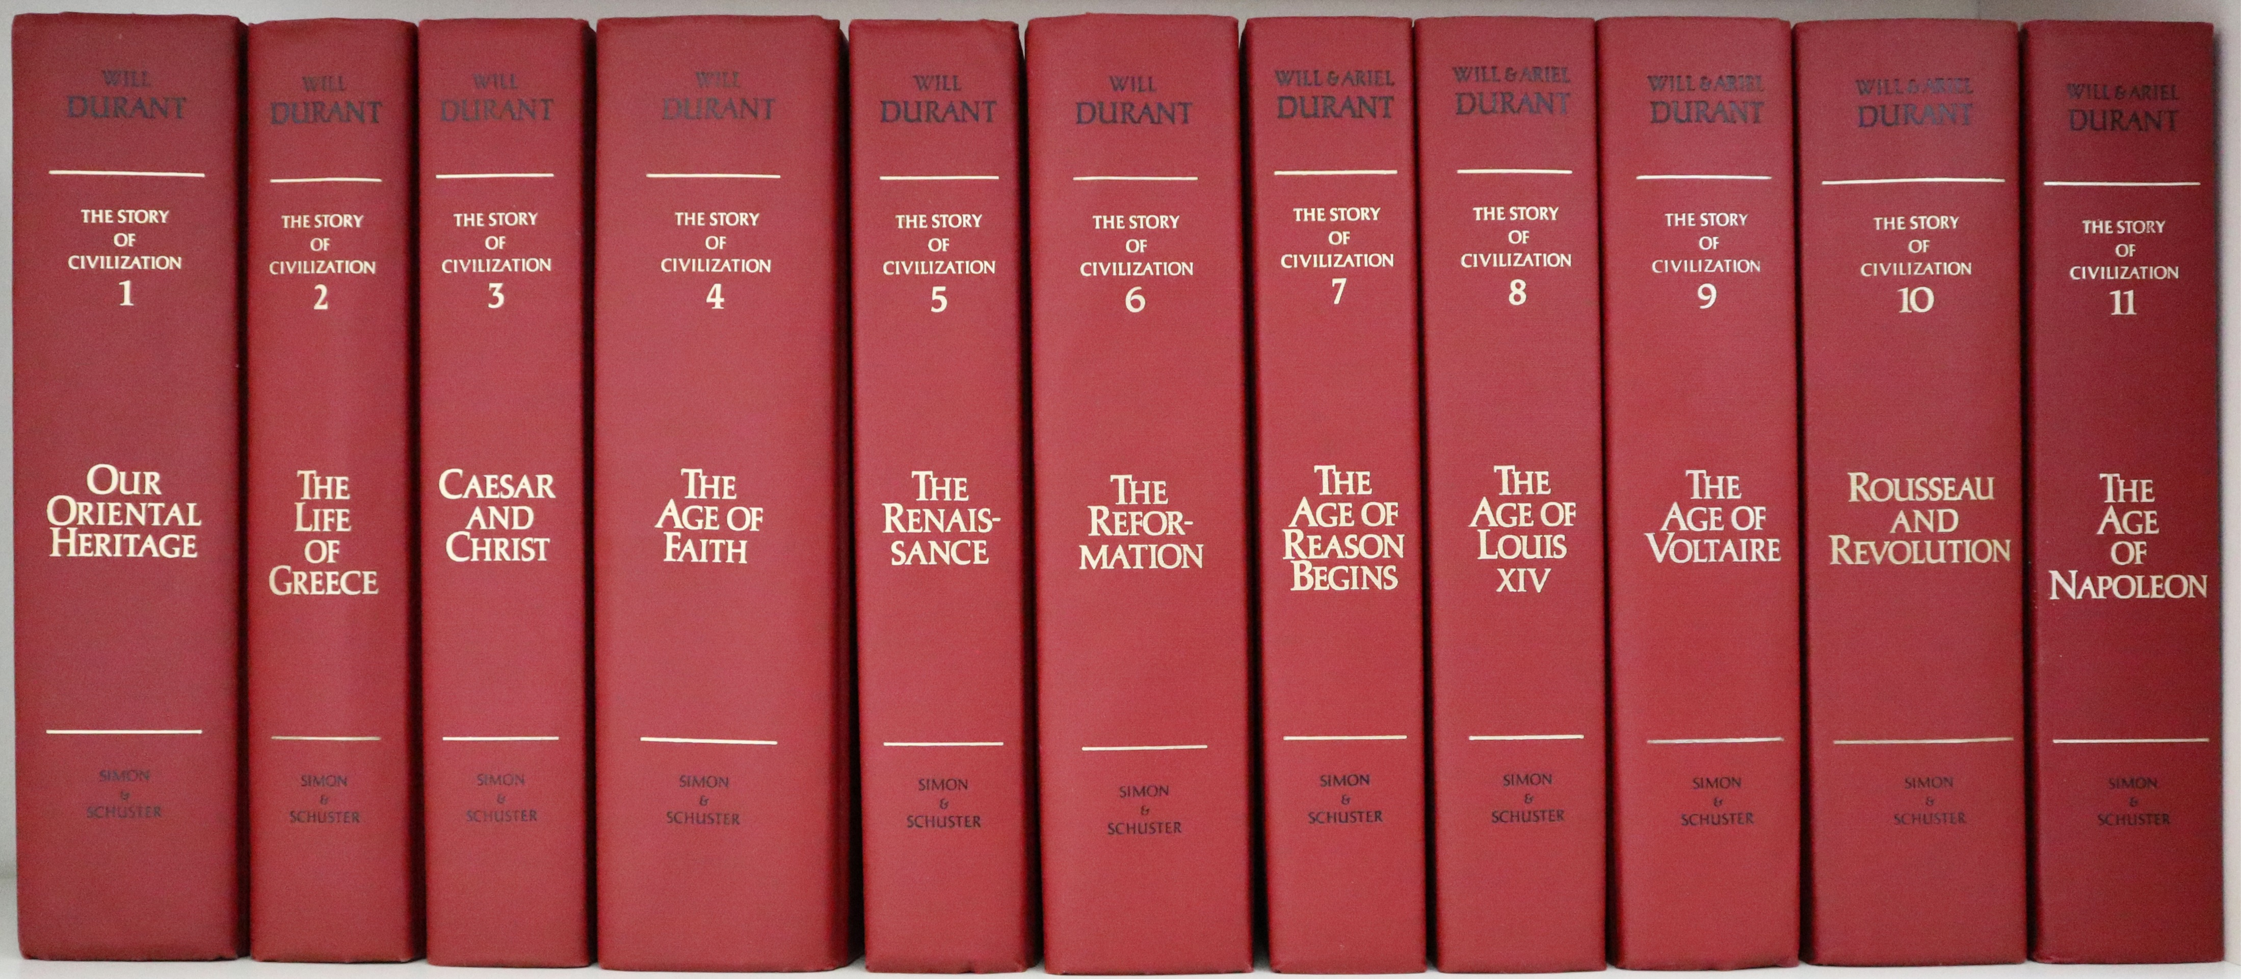
I inspired by:
Renewable energy
Human Archaeology and Ancient of Iraq
,they have had
the greatest impact on me.
The Story of Civilization by Ariel Durant and Will Durant
Human–computer interaction

Slide 5
Problem Statement and Motivation

Slide 6
AI has played a major role in the digitalization of society and creating new technologies than ever before, but, on the other hand,
Ethics, principles, democracy, equalities, criminal justice and morality are important human features and AI still grow uncontrollably lack of these features, without any scientific models, or theoretical foundation that could investigate, evaluate, improve and invest in the AI Techs regarding to human development

Slide 7
AI Techs in Digital Humanities and Digital Knowledge is a Hot Project It is happening now

Slide 8
We live in world of AI fake news and propaganda

Slide 9

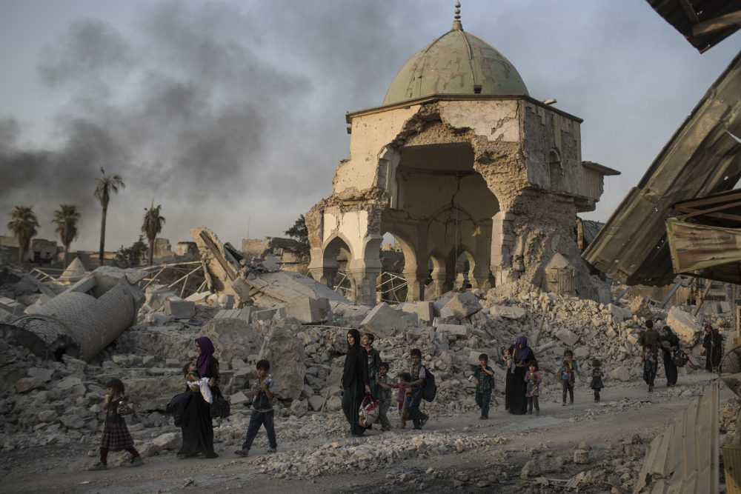
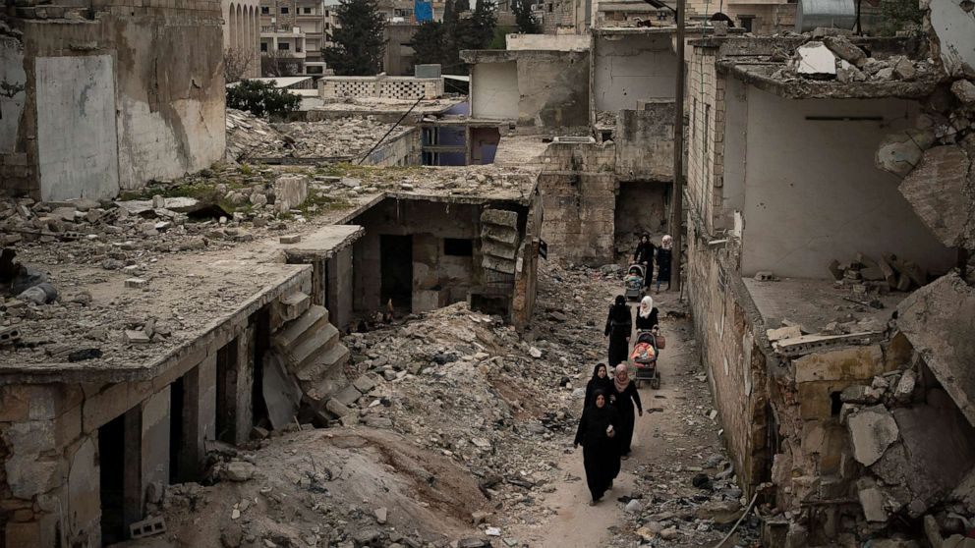
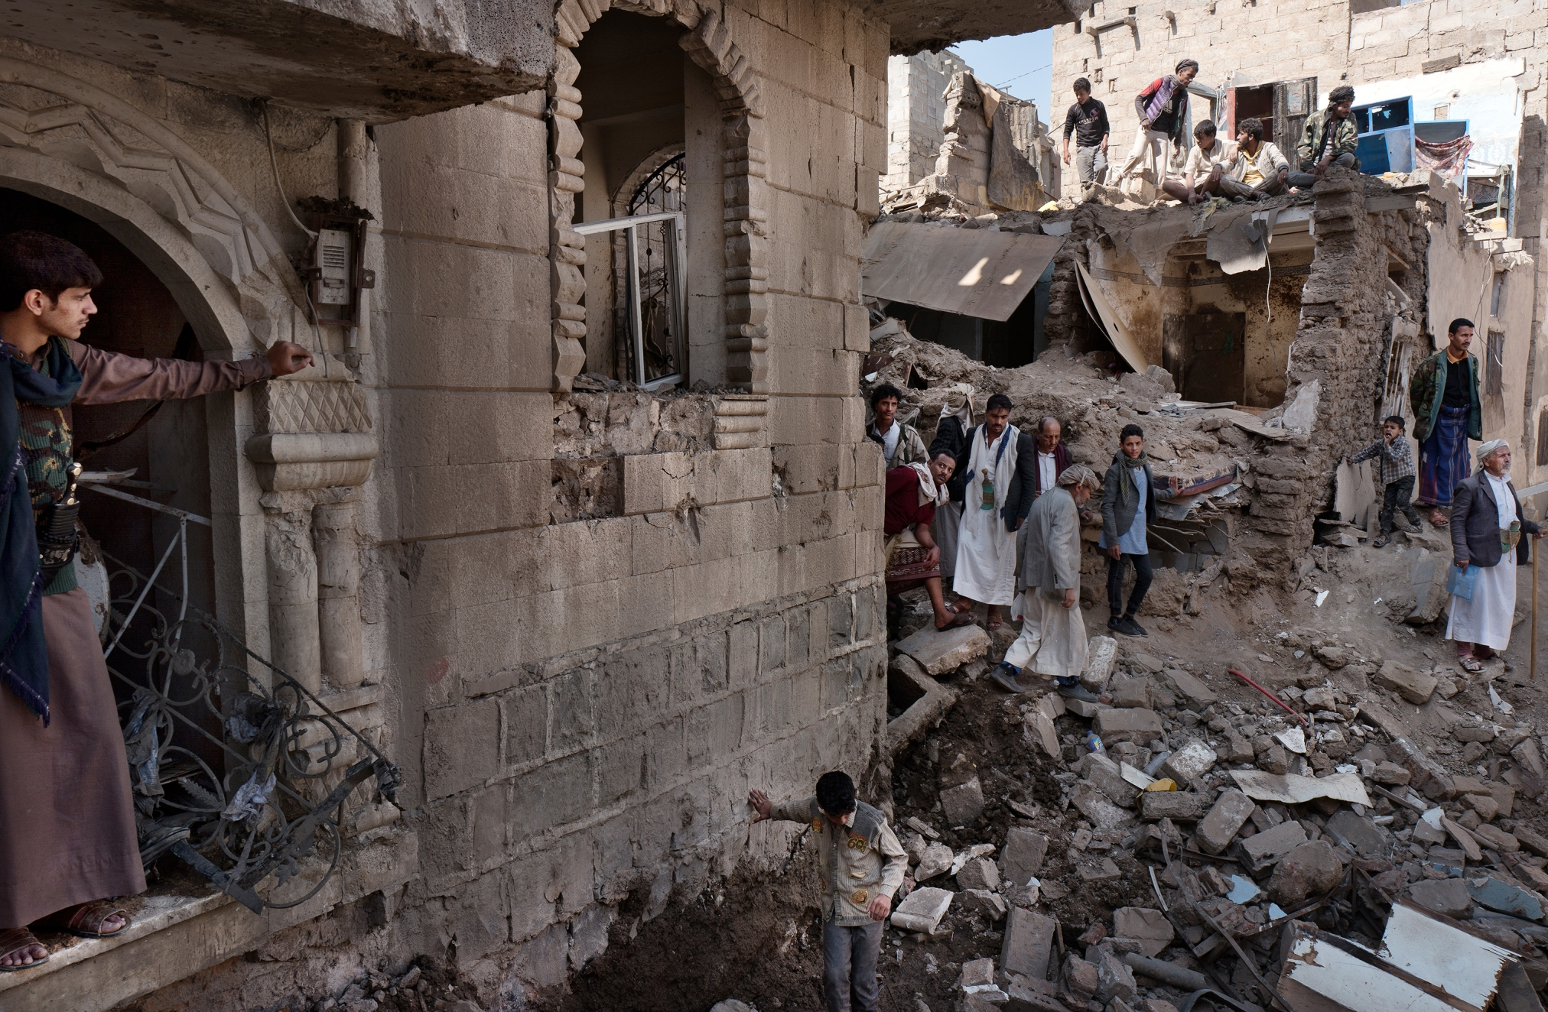
The Outcome of fake news and propaganda – War is Peace
Ukrainian war
Iraq War
Syrian civil war
Yemeni civil war

Slide 10
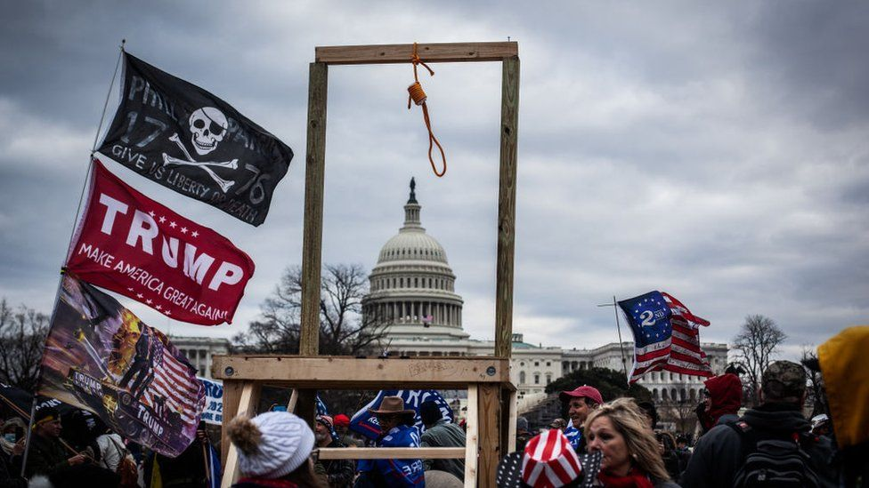
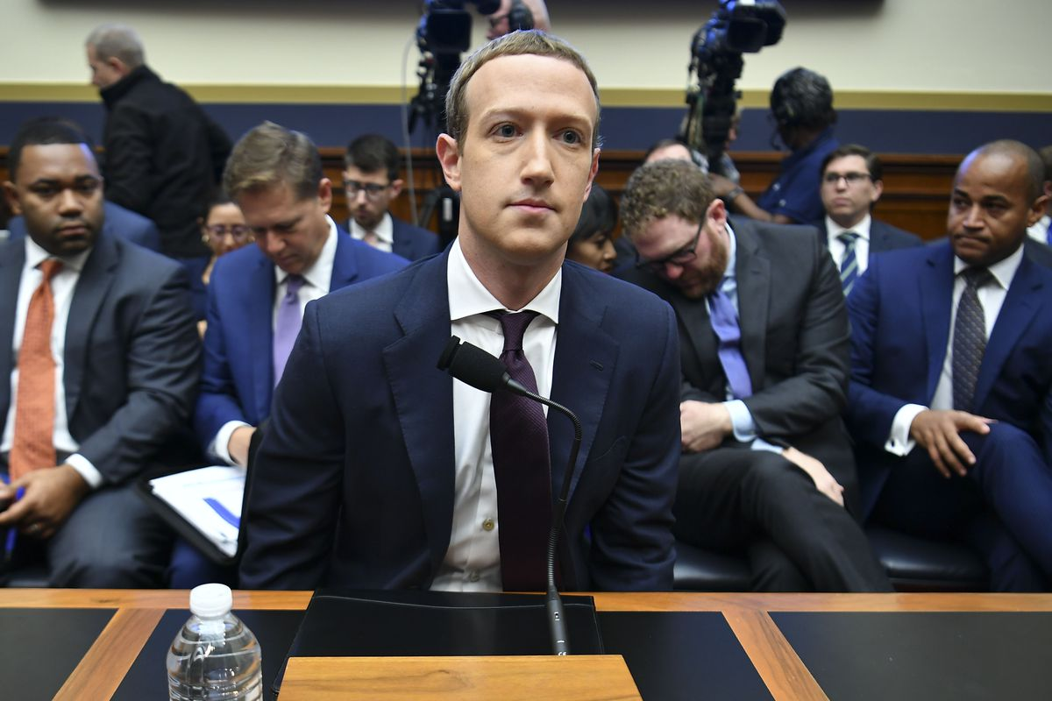
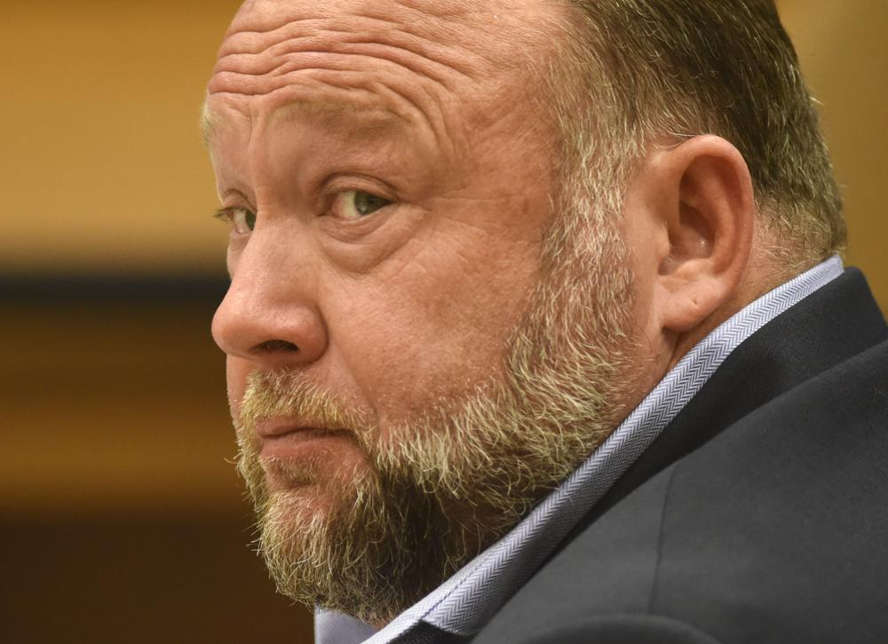
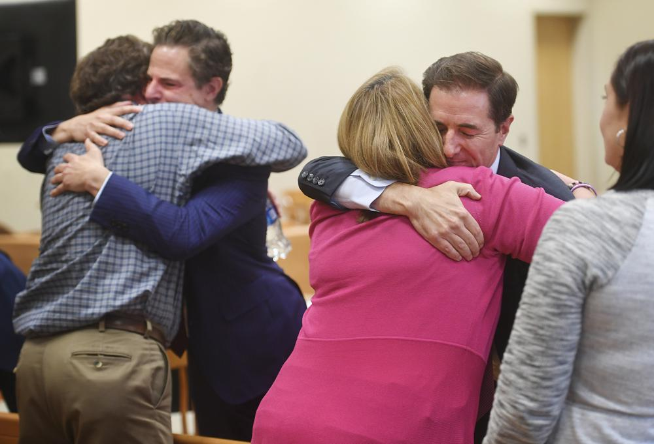
The Outcome of fake news and propaganda. Freedom Is Slavery
January 6 United States Capitol attack, 2021
Mark Zucker U.S. congress testimony on data privacy, fake news, global influence and past berg mistakes, 2020
Alex Jones court Sandy Hook Elementary School shooting

Slide 11
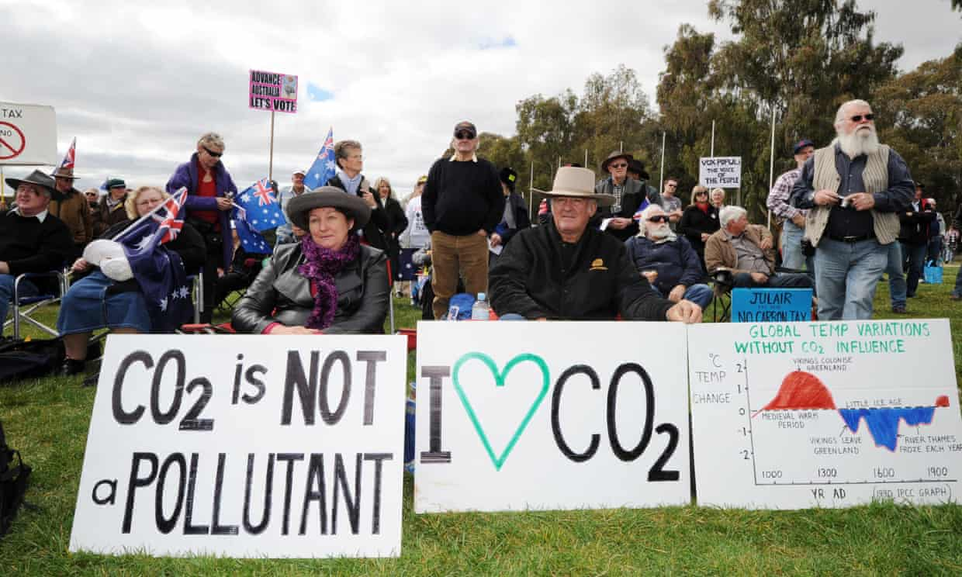
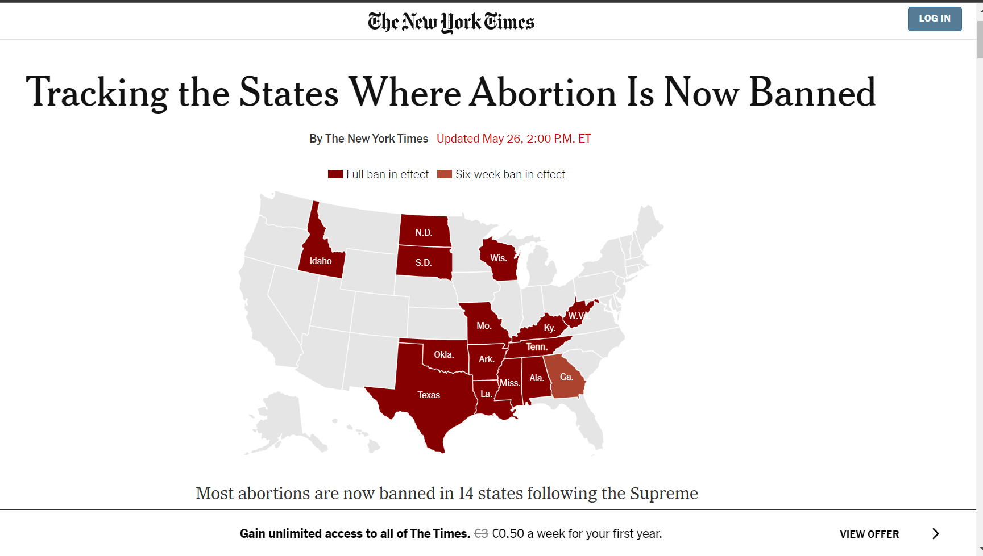
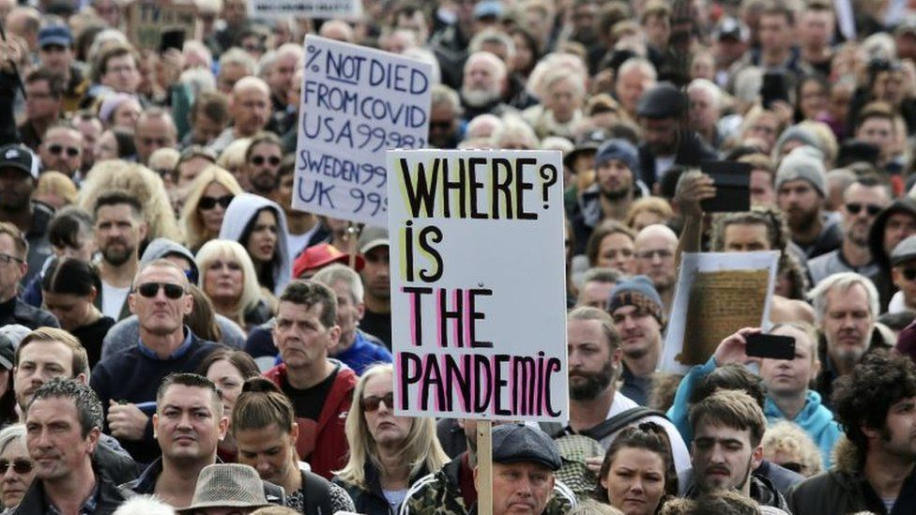
The Outcome of fake news and propaganda. Ignorance Is Strength.
Climate change is now denied
Abortion is now banned
Covid anti-vaxxer

Slide 12
We live in these outcomes, they are the biggest threat modern humans have ever faced, and still happening now in (2023) the time I am writing this presentation, therefore, together, with history, archival science, digital humanities, media technology, and computer science, we should start quickly in this project to address and investigate these challenges and to contribute new knowledge to the fields, as soon as humanly possible.
Investigate and evaluate the AI Techs is required to empower people, transform lives, benefit the institutions and societies, help future-proof cultural heritage institutions, serve public interest, approaching the archival principles and humane development.

Slide 13
Research objective
The major research question will answer in this project are:
RQ1:
What would AI-based approaches on archival principles look like?
What possibilities do they suggest about humane AI development?
Do they counter the “black box” character of AI?
RQ2:
What benefits would an archival AI offer an institution and society?
Could it help future-proof cultural heritage institutions, i.e., foster heritage futures?
Can an archival AI, outside the archival setting, serve public interest (e.g., combating fake news and propaganda)?
The primary objective of this research is to develop a quantitative and qualitative methods to design an effective system to answer RQ 1 and RQ 2.

Slide 14
Purpose and aims
Overall, the scientific significance and novelty of the project responds to international and European incentives for ethical democratising and a more humane AI
Ongoing partnership, producing original research, training/teaching students and other highly qualified personal.
Generating a virtuous circle with: history, archival science, digital humanities, computer science and media technology.
Looking for feedback loop: to reinforce and exchange the knowledge capabilities and ideas with each party.

Slide 15
Background and Related Work

Slide 16
MONTRÉAL DECLARATION FOR A RESPONSIBLE DEVELOPMENT OF ARTIFICIALINTELLIGENCE 2018
AI Tools must respect the following PRINCIPLES:
WELL-BEING PRINCIPLE
RESPECT FOR AUTONOMY PRINCIPLE
PROTECTION OF PRIVACY AND INTIMACY
SOLIDARITY PRINCIPLE
DEMOCRATIC PARTICIPATION PRINCIPLE
EQUITY PRINCIPLE
DIVERSITY INCLUSION PRINCIPLE
CAUTION PRINCIPLE
RESPONSIBILITY PRINCIPLE
SUSTAINABLE DEVELOPMENT PRINCIPLE

Slide 17
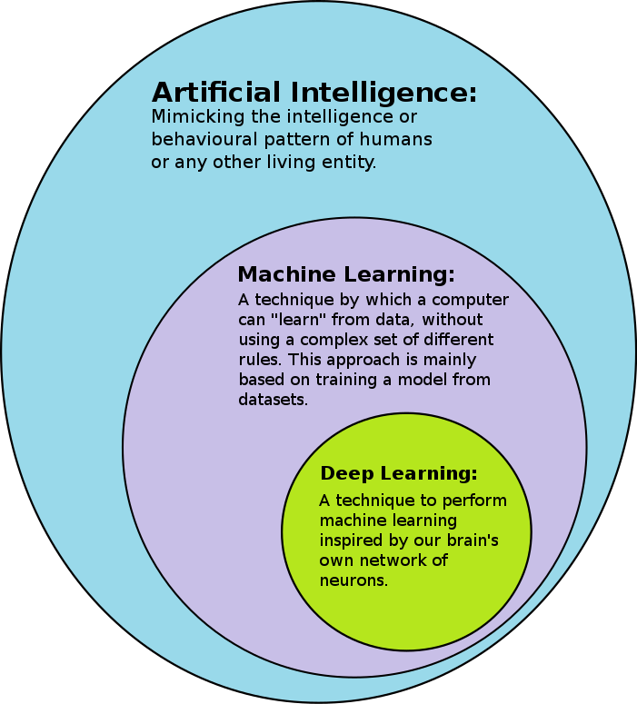
AI Technologies is a variety of digital technologies and methods for automated information processing and data mining.

Slide 18
Finding study
Study1: convert scanned manuscripts to a format that can be accessed by information retrieval systems or for further analysis.
Study2: recognition techniques to pre-process historical texts, thereby improving its clarity for accessing the records.
Study3: represent supervised machine learning to identify sensitive information in archival documents to facilitate ethical archival research
Study 4,5: techniques to make the AI model explainable
Study 6: shows that AI technologies are often treated as a (black box).
Study 7: about Archival practices: authenticity of purported records.
Study 8: Understanding authentication as dynamic and reflexive instead of static and stable.

Slide 19
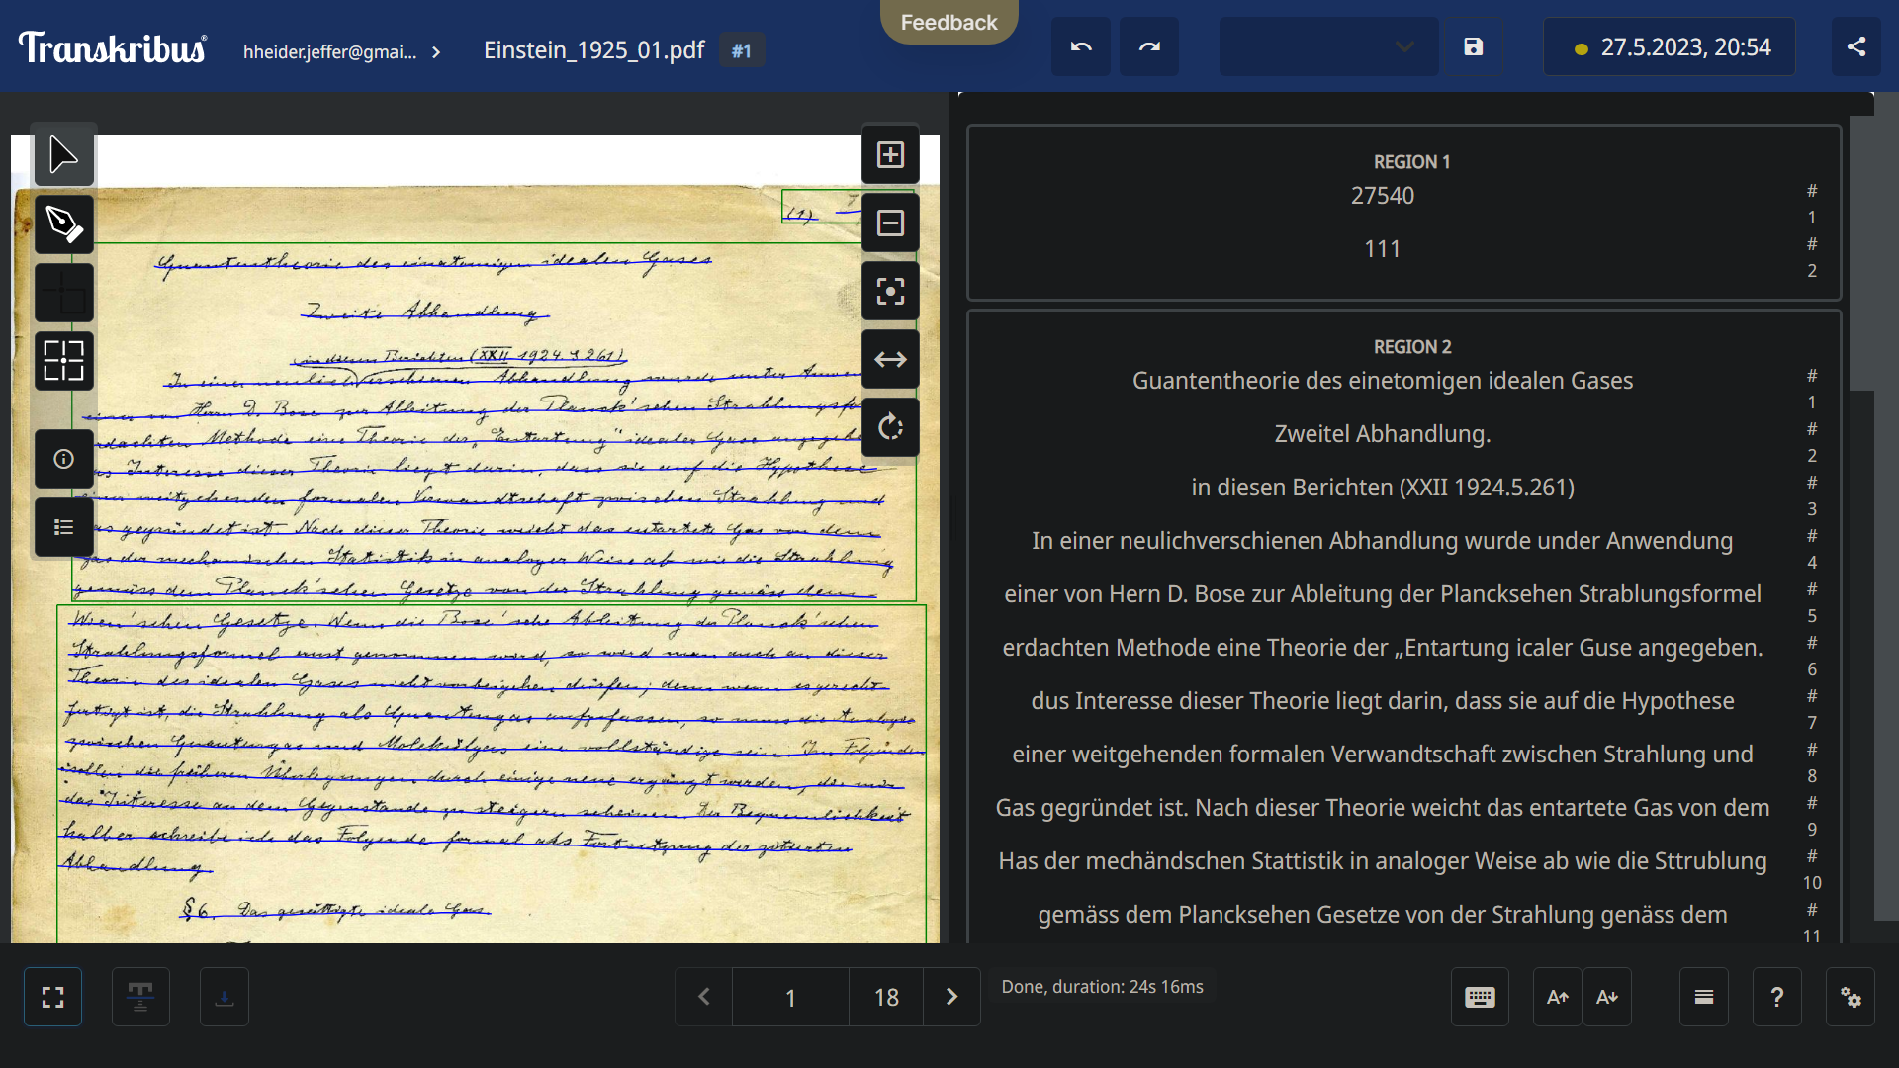
Einstein's 1925 manuscript, Study 1 & 2 experiments by Heider Jeffer at (Link) – Transkribus tool

Slide 20
Research Approach
Data collection
Data analysis
Software Architecture

Slide 21
Data collection
Step Import records from Swedish National Archives and the Swedish National Heritage
Step apply inclusion/ exclusion criteria
Step Record Quality Optimization
Step Convert Digitized-Record into computable formats (DOC, PNG, MP3, and MP4)
Step Extract the relevant information from the Digitalized-Records From the digitalized records extract the following info.:
Name of the record
Type of the Record: (False Information, cultural heritage, or Human Development)

Slide 22
Data analysis
AI in False Information analysis
Use AI tools to track and extract (False Information) topic from the data (DOC, MP3 and MP4)
Definition the AI Attack:
AI who Create Fake Post in Web
AI who Spread Fake Post to group of people
Definition AI Defense:
AI Fake News Detector to detect Create Fake Post
AI SocialBot Detector to detect Spread Fake Post
To understand the AI applications and how these technologies can support the spread of misinformation (AI-Powered Fake News 2.0).
misinformation = Fake news, False News, Satire news, Disinformation, Misinformation, and Rumer.

Slide 23
Data analysis
AI Techs in cultural heritage analysis Use AI tools to track and extract (cultural heritage) topic from the data (DOC, MP3 and MP4) : Society, Language, Culture, Religion , Geographic, Population, Capita, Political system,

Slide 24
Data analysis
AI Techs in humane development analysis
Use AI tools to track and extract (humane development ) topic from the data (DOC, MP3 and MP4) to do the following:
Country, Condition of Dev,, Empowerments, Education state, Civil rights state, Climate Change state(Sustainability), LGBTQ state, Woman Rights State, Human Rights State, Equal opportunity, Health Care system, Criminal Justice State, Transparency state, Access to public info state, (by UN measurement)

Slide 25
Finally, by following the above steps we will answer the RQS addressed in this project
AI Techs is required to empower people, transform lives, benefit the institutions and societies, help future-proof cultural heritage institutions, serve public interest, approaching the archival principles and humane development.

Slide 26
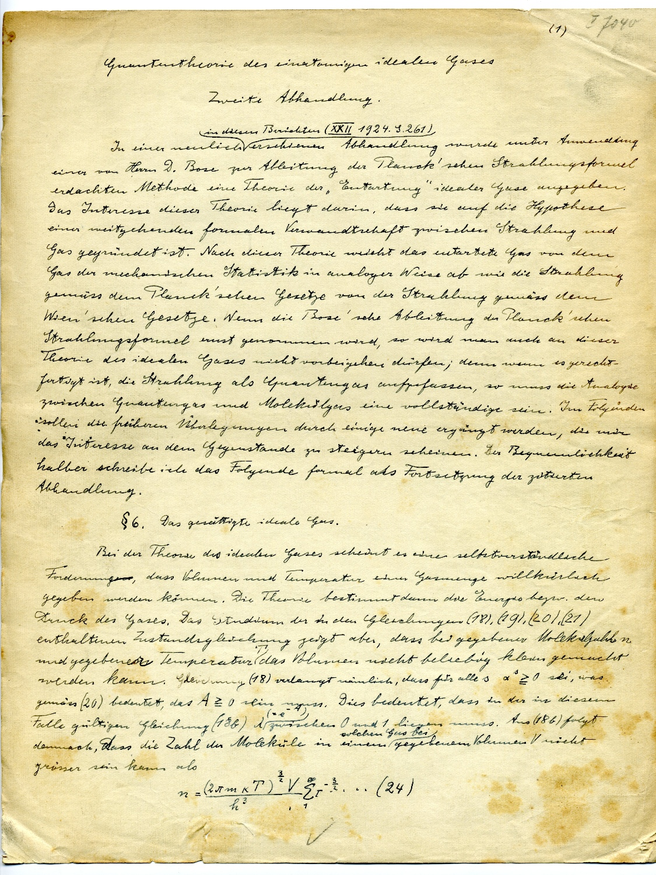
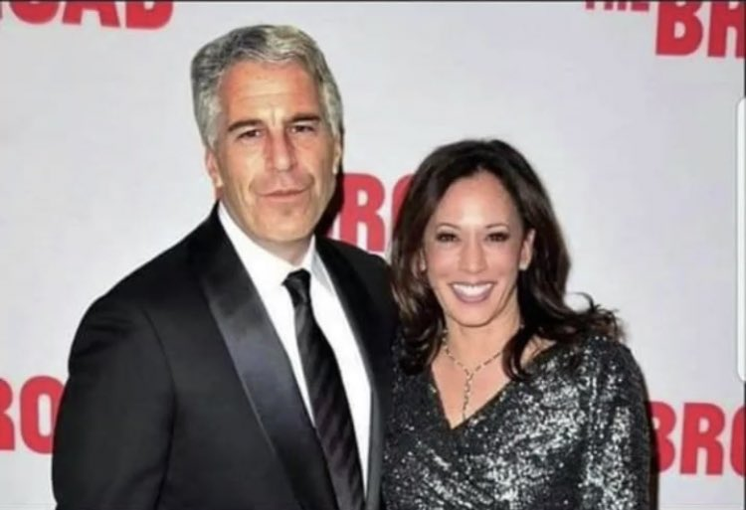
Software Architecture
UI Layer
(Output)
Logic Layer
Data collection
Optimization: optimize quality of record
Digitization: digitize record into computable formats (Doc,PGN,MP4,MP3)
Extract the relevant information from the Digitalized-Records
Name of the record
Type of the Record: (False Information, cultural heritage, or Human Development)
Data analysis
AI in False Information analysis
misinformation = Fake news, False News, Satire news, Disinformation, Misinformation, and Rumer
AI Techs in cultural heritage analysis
AI Techs in humane development
DB – Layer
Input Records

Slide 27
Plan DRP 1 , and DRP 2
DRP1 | DRP 2
(Thesis article 1): the state-of-the-art ML and DL technologies will be used to assess their documented and posited positive and negative implications to different types of authenticities | (Thesis article 1): investigate which ML and DL models can be best used to analyse and establish
(Thesis article 2): exploratory assessments with selected bodies of archival material from the RA and RAÄ will be conducted to investigate the impact of algorithmic processing on their normative | (Thesis article 2): maintain the authenticity of historical evidence held at archival institutions
(Thesis article 3): experienced authenticity | (Thesis article 3): experiments will be conducted to enrich historical records by using natural language processing.
(Thesis article 4): the overall analysis of these efforts and their implication for the CHS will serve as the basis for a final publication. | (Thesis article 4): an evaluation methodology is developed and tested for its practical applicability.

Slide 28
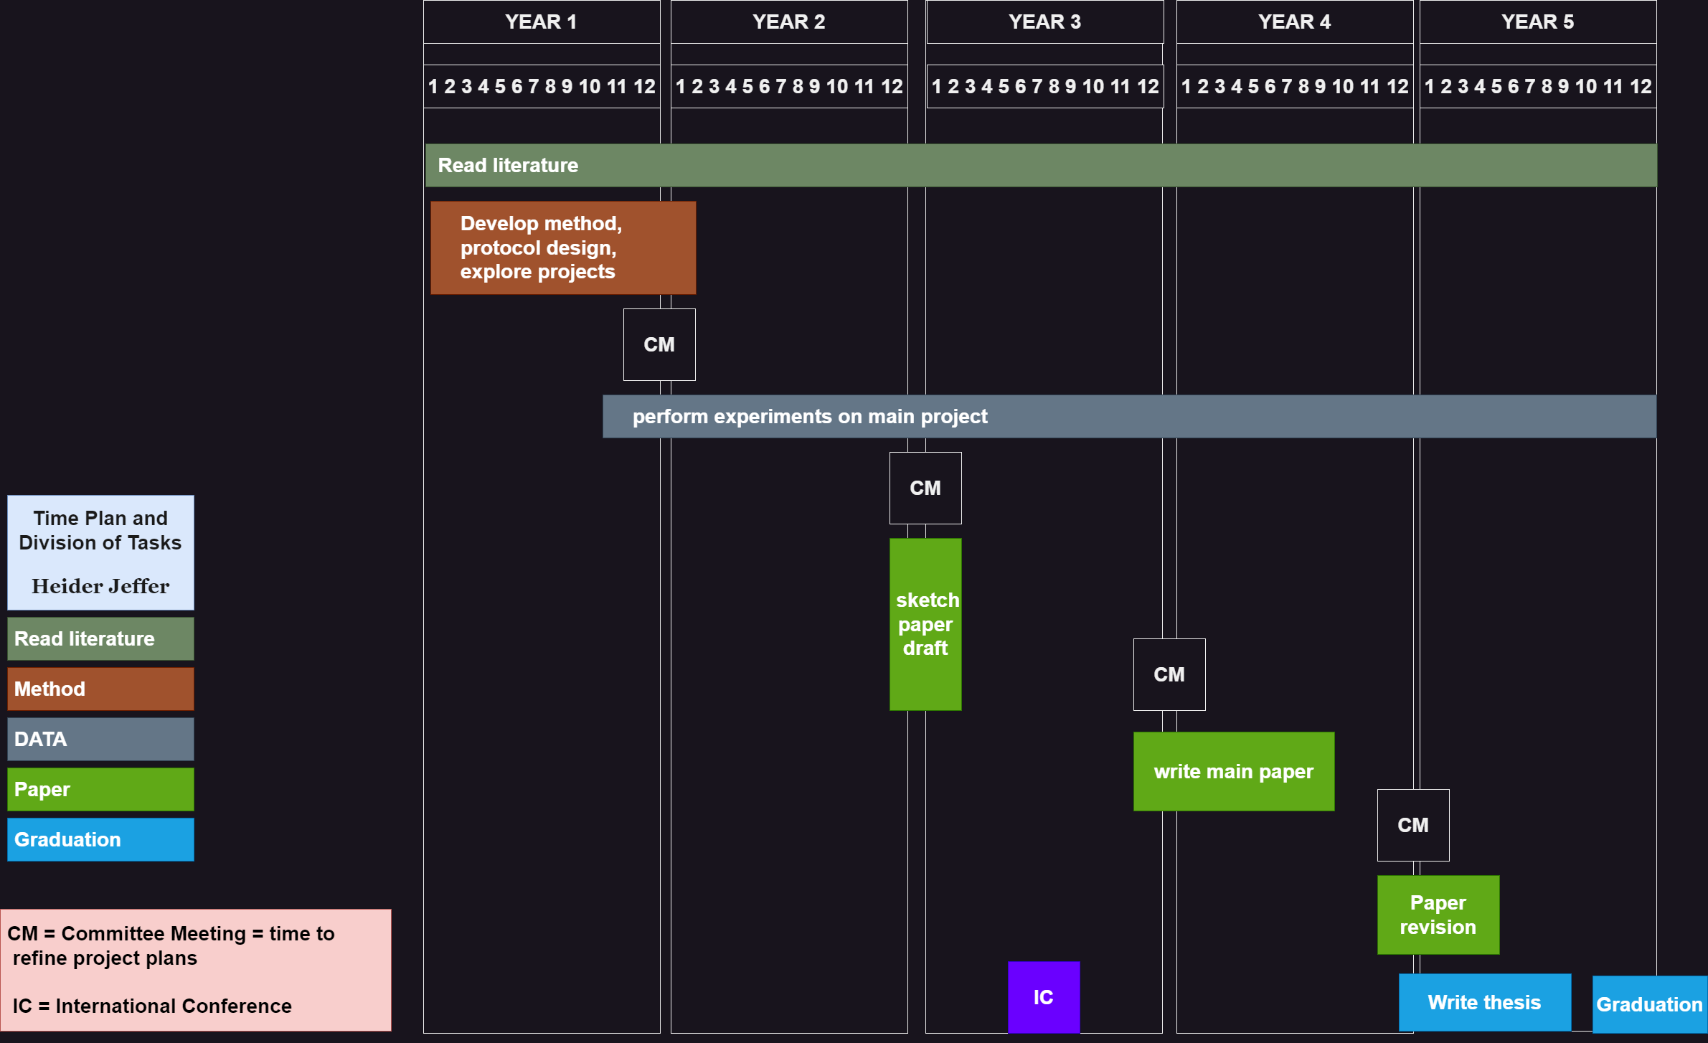

Slide 29
Project Contribution to WASP-HS

Slide 30
Bibliography
Koraljka Golub and Ying-Hsang Liu.(2022). Information and Knowledge Organisation in Digital Humanities Global Perspectives, Modelling cultural entities in diverse domains for digital archives 25-30
Aejas, B., Bouras, A., Belhi, A., & Gasmi, H. (2021). Named Entity Recognition for Cultural Heritage Preservation. In Data Analytics for Cultural Heritage (pp. 249-270). Springer, Cham. Alberti, M., Seuret, M., Pondenkandath, V., Ingold, R., & Liwicki, M. (2017, November). Historical document image segmentation with LDA-initialized deep neural networks. In Proceedings of the 4th international workshop on historical document imaging and processing (pp. 95-100).
Bašić, B.D., M-F. Moens and M. Tadić. (2009). Computer-Aided Document Indexing for Accessing Legislation: A Joint Venture between Flanders and Croatia, in M. Tadić, B.D. Bašić and M-F. Moens (eds) Technologies for the Processing and Retrieval of Semi-Structured Documents: Experience from the CADIAL Project: 3-14. Zagreb: Croatian Language Technologies Society.
Available at: http://cadial.org/papers/cadial_book_ch01.pdf
Bradshaw, S., & Howard, P. N. (2018). The global organization of social media disinformation campaigns. Journal of International Affairs, 71(1.5), 23-32. Available at: https://ora.ox.ac.uk/objects/uuid:67cd8a98-8b3c-45c0-b07f-5e25b25ea67a
Coeckelbergs, M. and S. Van Hooland. (2021). Machine learning techniques for the management of digitised collections, in K. Golub and Y-H. Liu (eds) Information and Knowledge Organisation in Digital Humanities: 244-259. London: Routledge.
Duranti, L. (1989). Diplomatics: New Uses for an Old Science, Archivaria 28, 7-27
Duranti, L. (1995). Reliability and authenticity: The concepts and their implications. Archivaria 39(10): 5-10. Available at: https://archivaria.ca/index.php/archivaria/article/view/12063 Duranti, L. (2010). Concepts and principles for the management of electronic records, or records management theory is archival diplomatics. Records Management Journal (London, England), 20(1), 78-95.
Foka, A., Attemark, J., & Wahlberg, F. (2022). Women’s metadata, semantic web ontologies and AI. Emerging Technologies and Museums: Mediating Difficult Heritage. London and NY: Bergham, 65-88. Available at: http://uu.diva- portal.org/smash/record.jsf?pid=diva2%3A1643134&dswid=2221

Slide 31
Bibliography
Granell, E., Chammas, E., Likforman-Sulem, L., Martínez-Hinarejos, C. D., Mokbel, C., & Cîrstea, B. I. (2018). Transcription of Spanish historical handwritten documents with deep neural networks. Journal of Imaging, 4(1), 15.
Holtorf, C. and A. Högberg (eds). (2021). Cultural Heritage and the Future. London: Routledge. Hutchinson, T. (2018). Protecting privacy in the archives: Supervised machine learning and born- digital records. In 2018 IEEE International Conference on Big Data (Big Data) (pp. 2696-2701). IEEE.
Lee, C. A. (2018). Computer-assisted appraisal and selection of archival materials. In 2018 IEEE International Conference on Big Data (Big Data) IEEE. Lemieux, V. L. (ed.). 2016. Building trust in information. Cham: Springer, pp. 2721-2724, https://doi.org/10.1007/978-3-319-40226-0 Murphy, O. & Villaespesa, E. (2020). AI: A Museum Planning Toolkit. Discussion Paper. Goldsmiths, University of London, London.
Philips, J., & Tabrizi, N. (2020). Historical Document Processing: A Survey of Techniques, Tools, and Trends. KDIR, 341-349.
Raji, I.D., Gebru, T., Mitchell, M., Buolamwini, J., Lee, J., & Denton, E. (2020). Saving Face: Investigating the Ethical Concerns of Facial Recognition Auditing. Proceedings of the AAAI/ACM Conference on AI, Ethics, and Society. Association for Computing Machinery, New York, NY, USA, 145–151.
Roach, L. (2021). Forgery and Memory at the End of the First Millennium. New Jersey: Princeton University Press.
Robinson, S. C. (2020). Trust, transparency, and openness: How inclusion of cultural values shapes Nordic national public policy strategies for artificial intelligence (AI). Technology in Society, 63, 101421.
Silverman, H. (2015). Heritage and Authenticity, in E. Waterton and S. Watson (eds). The Palgrave Handbook of Contemporary Heritage Research: 69-88. London: Palgrave Macmillan.
Spinner, T., Schlegel, U., Schäfer, H., & El-Assady, M. (2019). explAIner: A visual analytics framework for interactive and explainable machine learning. IEEE transactions on Visualization and Computer Graphics, 26(1), 1064-1074.
Sporleder, C. (2010). Natural language processing for cultural heritage domains. Language and Linguistics Compass, 4(9), 750-768.
Tzouganatou, A. (2021) Openness and privacy in born-digital archives: reflecting the role of AI development. AI & Society. https://doi.org/10.1007/s00146-021-01361-3

Slide 32
APPENDIX

Slide 33
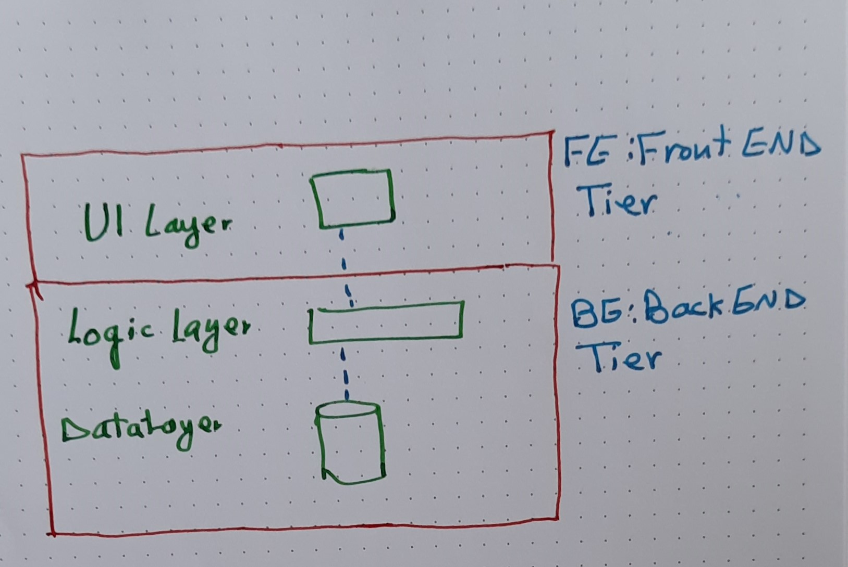
Project’s Software Architecture

Slide 34
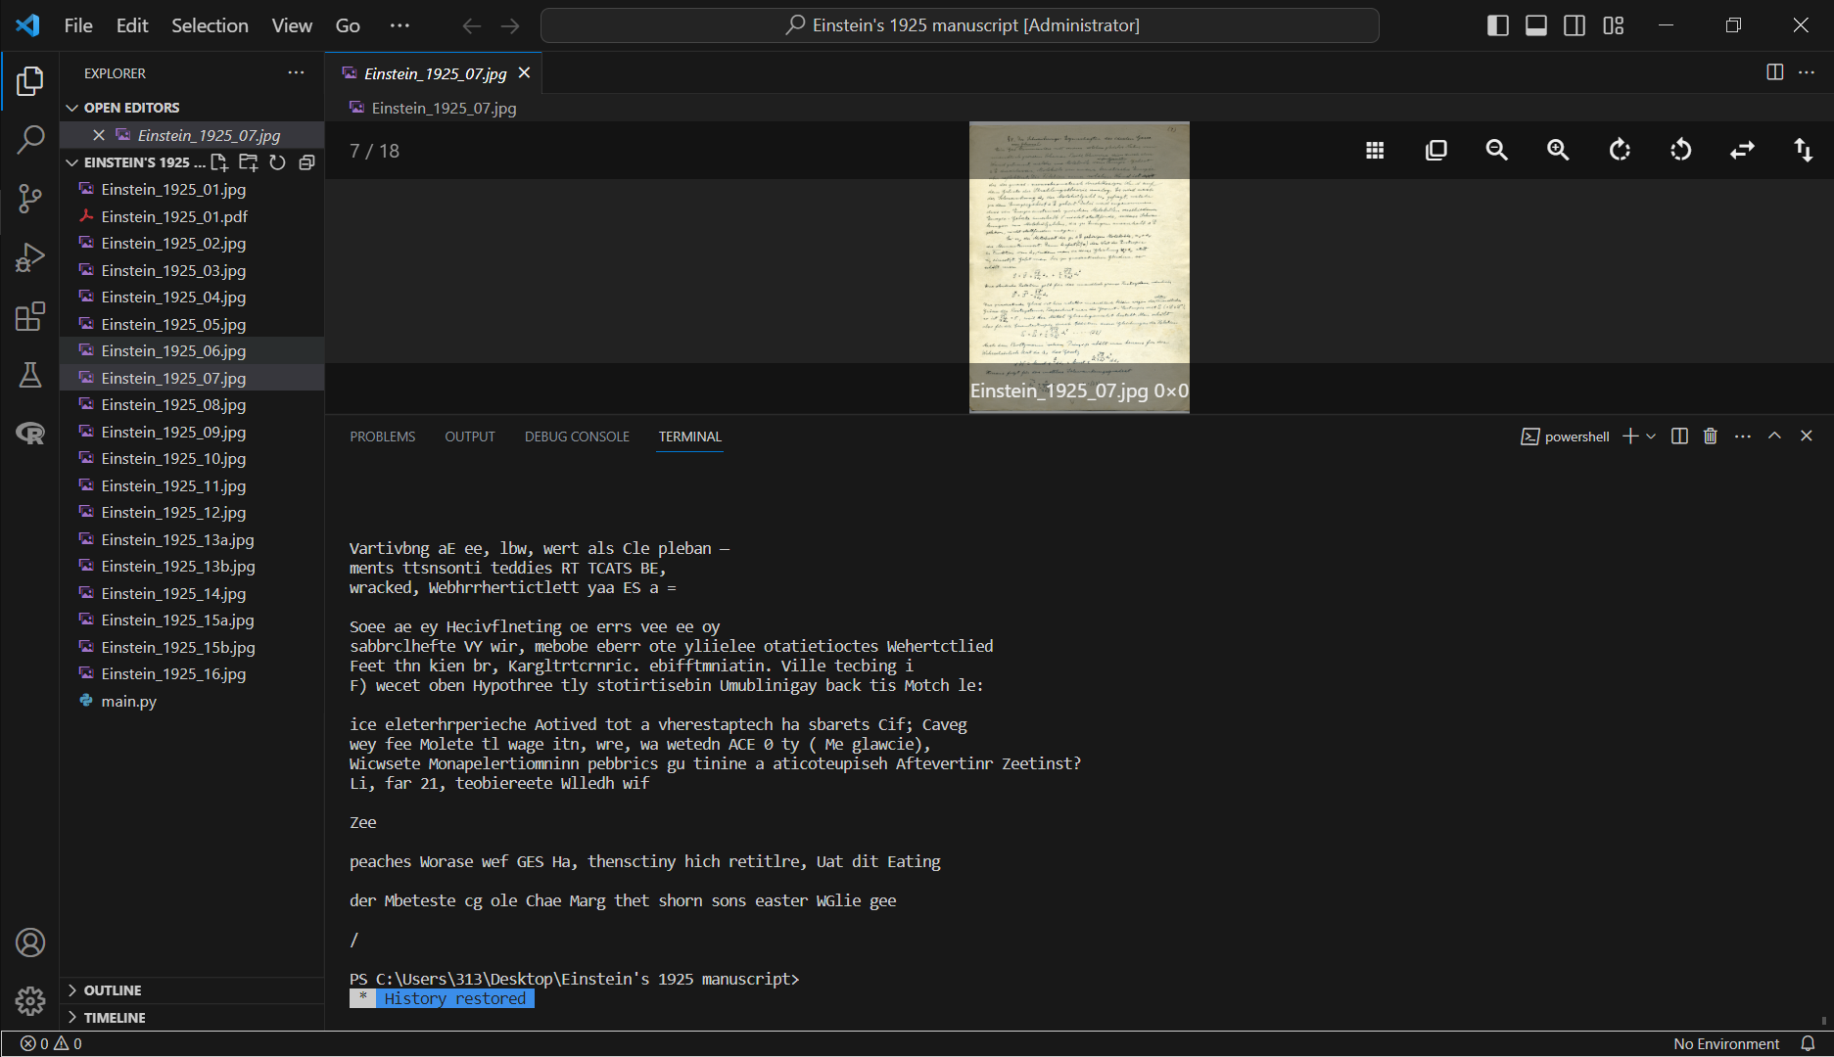
Einstein's 1925 manuscript, Python – Tesseract, by Heider Jeffer.

Slide 35
Please don’t forget to follow this project at GitHub
AT: https://github.com/HeiderJeffer/Ph.D-position-at-Linnaeus-University

Slide 36

Thank You

Slide 37
Questions, please?

